Slide 1
Static magnetic field using higher order hierarchic H(curl) conforming finite elements
https://github.com/kamearia/EMPY_Analysis/Static
High order Nedelec elements with local complete sequence properties
Joachim Schoberl and Sabine Zaglmayr
COMPEL: The International Journal for Computation and Mathematics in Electrical and Electronic Engineering, Vol. 24 No. 2, 2005
Hcurl(nograd=true order=8) for A
H1(order=8) for Ω
Python with netgen/ngsolve
( https://ngsolve.org/ )

Slide 2
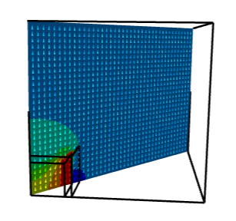
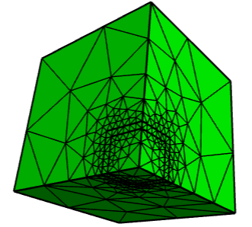
Cube 2m*2m*2m μr=1000
1/8 region with simmetricity
1T Uniform field in z direction
Total domain 1.2*1.2*1.2
Reduced domain 5*5*5
Bn=0 on the boundary
FE order 8
ICCG eps=10⁻⁸
nv= 384 nedge= 2151
nfacet= 3328 ne= 1560

Slide 3
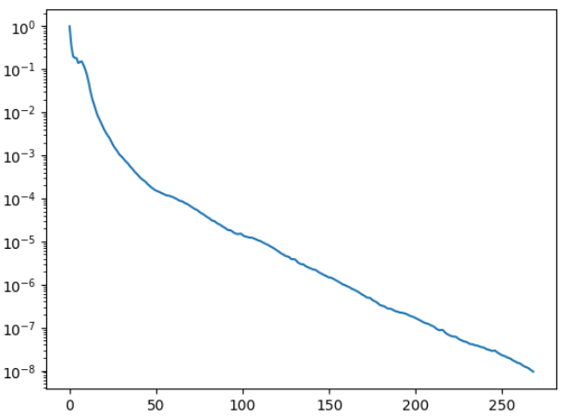
A-Ar
Dof= 315370
Nonzeros= 111303072
shift parameter= 1.02
minimum residual= 9.488181961272888e-09 at iteraions: 268
center magnetic field
= (1.2601636930633878e-11, -2.9647877868046543e-07, 3.446368332228351)
magnetic energy= 11541.379446089919
経過時間: 176.1111 秒

Slide 4
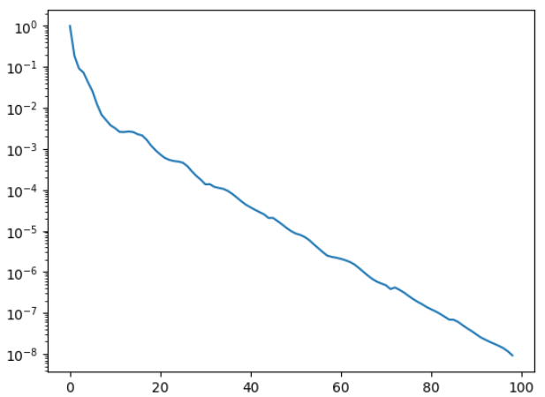
Ω-Ωr
Dof= 135944
Nonzeros= 34965270
shift parameter= 1.01
minimum residual= 9.234648703853246e-09 at iteraions: 98
center magnetic field
= (1.5102343358934567e-11, -4.231033382380488e-12, 3.4476356299040027)
magnetic energy= 11568.97631021465
経過時間: 28.7880 秒

Slide 5
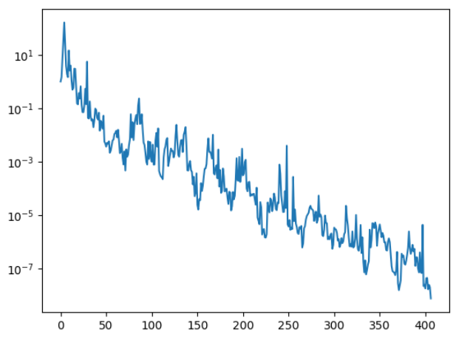
A-Ωr
Dof= 225059
Nonzeros= 71419621
shift parameter= 1.02
minimum residual= 7.435276405447754e-09 at iteraions: 406
center magnetic field
= (0.0, -2.4790426680963306e-07, 3.4463682167354857)
magnetic energy= 11541.379590852714
経過時間: 108.1370 秒

Slide 6
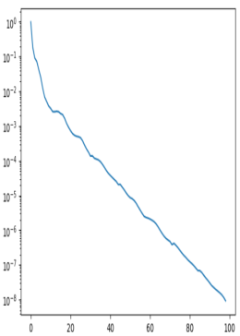
 | A-Ar | Ω-Ωr | A-Ωr
DOF | 315370 | 135944 | 225059
Nonzeros | 111303072 | 34965270 | 71419621
Niter | 268 | 98 | 406
Ticcg | 91.5 | 13.6 | 84.1
dt | 3.07E-09 | 3.98E-09 | 2.90E-09
Bz(T) | 3.4463683 | 3.4476356 | 3.4463682
Wm(J) | 11541.379 | 11568.976 | 11541.380
A-Ar
Ticcg: time for preconditioning and iterations
dt=Ticcg/Nonzeros/Niter
Bz(T): Bz at cube center (0,0,0)
Wm(J): Magnetic energy in the cube
dt is nearly constant.
Ω-Ωr
A-Ωr

Slide 7
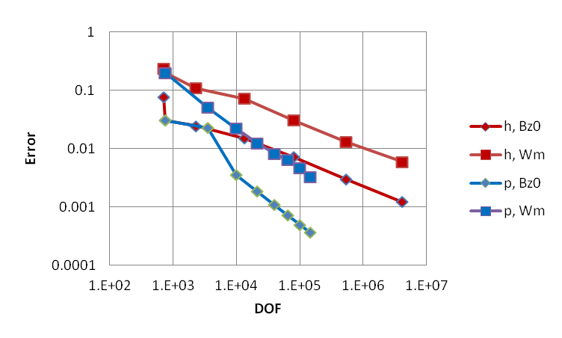
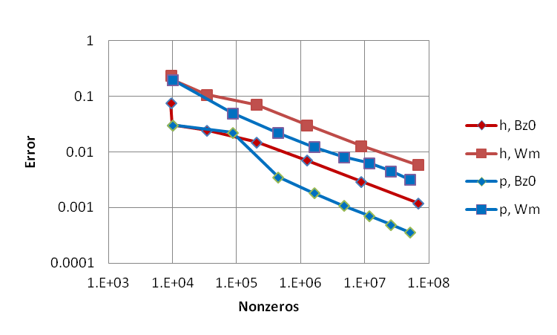
A-Ar
Error ∝ Ndof^{1/2} -- h
∝ Ndof -- p
Nnz∝ Ndof^{1/2} -- h
∝ Ndof -- p
Error ∝ Nnz^{1/2} -- h, p
Error(h) =〜2 Error(p) – Bz0
Error(h) =〜4 Error(p) – Wm

Slide 8
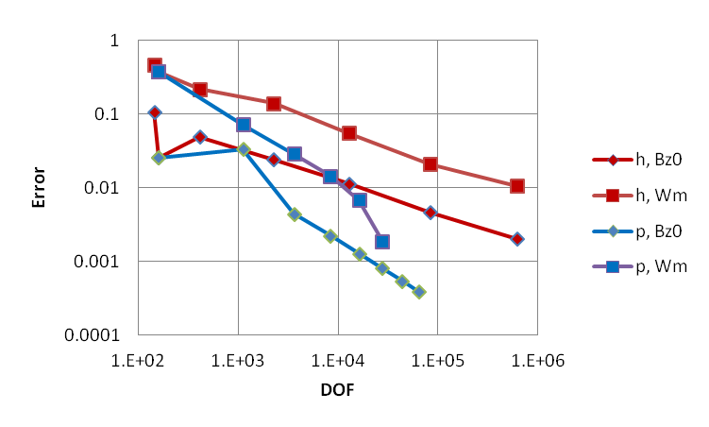
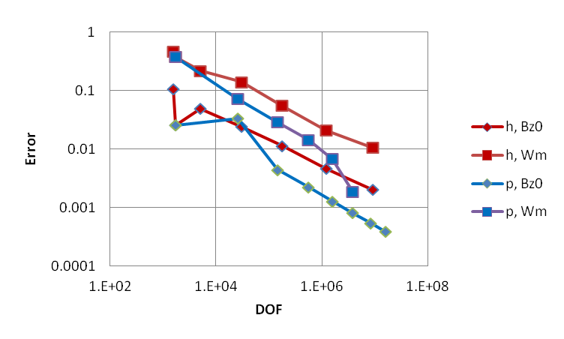
Ω-Ωｒ
Error ∝ Ndof^{1/2} -- h
∝ Ndof -- p
Nnz∝ Ndof^{1/2} -- h
∝ Ndof -- p
Error ∝ Nnz^{1/2} -- h, p
Error(h) =〜2 Error(p) – Bz0
Error(h) =〜4 Error(p) – Wm

Slide 9
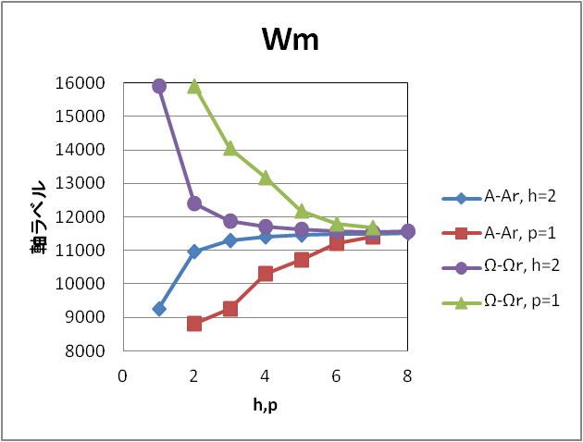
Error(Ω-Ωr) = 〜2 Error(A-Ar)
for same h, p

Slide 10
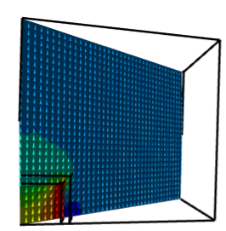

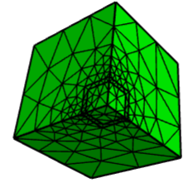
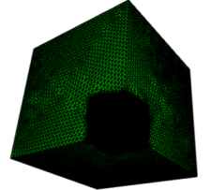
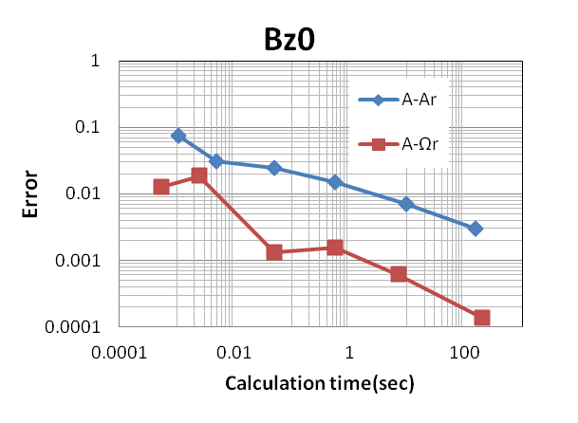
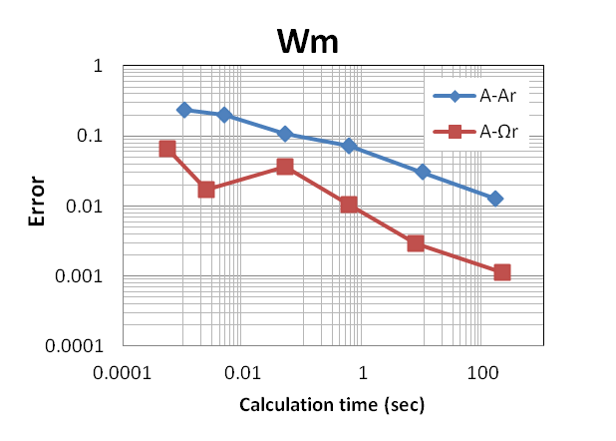
A-Ar法とA-Ωr法
同じ計算時間でA-Ωr法の方が一桁ほど精度が良い！
Bz at cube center
Magnetic energy in cube

Slide 11
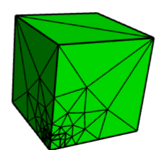
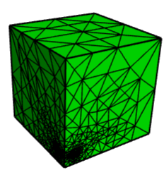
Adaptive meshing (Ω-Ωｒ法） feOrder=3
Initial Mesh
Ne=150, Ndof=783,Nnonzero=26111
Mesh after 10 Refinement
Ne=243903, Ndof=1108002,
Nnonzero=53237796

Slide 12
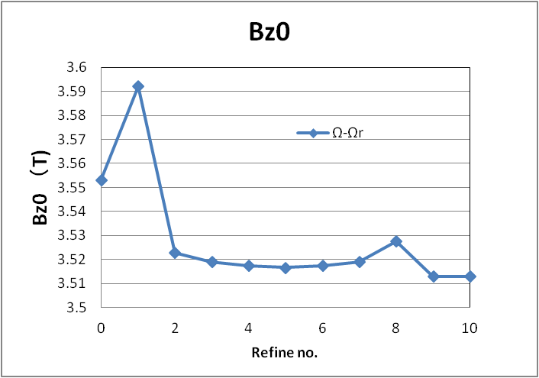
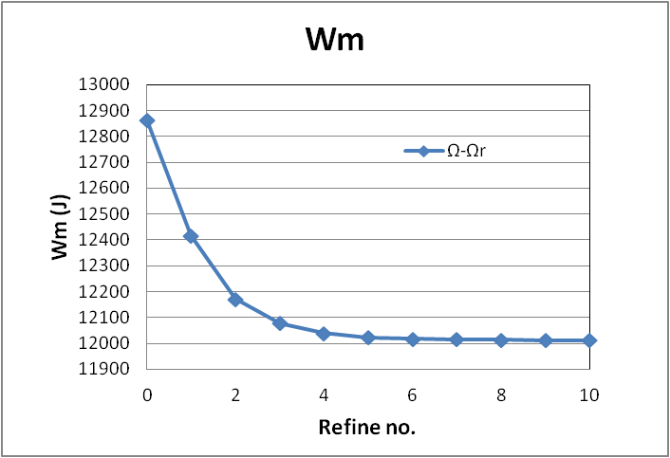

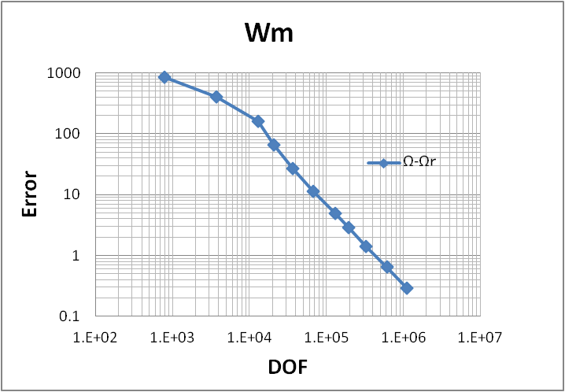
Adaptive meshing (Ω-Ωｒ法） feOrder=3
一点の磁場は滑らかに収束しない、
磁気エネルギの積分量は滑らかに収束。
評価点(0,0,0)近傍は細分割されない。
磁場は一様で誤差が小さいと評価される。

